Slide 1


Dynamic AI Traffic Light System
By:- Analytic Avengers
Team Members:-
Kunal Dhand
Aditya Thakur
Shashank Gulati
Ayush Munot
Lakshay Tyagi
Ritesh Mohanty

Slide 2
1
Introduction
2
Working of AI Traffic System
3
Benefits
Contents
4
Conclusion
5
References

Slide 3
Dynamic AI Traffic Light System
Traffic congestion is a major problem that affects people's daily lives. One of the factors that contribute to congestion is the timing system of traffic lights. Congestion can cause increased fuel consumption, air pollution, wasted time and energy, and pavement damage. A potential solution to this problem is to implement an AI traffic system that dynamically adjusts the timing of traffic lights based on the volume of traffic.
A dynamic AI traffic light system is a traffic management system that uses artificial intelligence (AI) and real-time data to adjust the timing of traffic lights based on the volume of traffic. By dynamically adjusting traffic light timings, the system can reduce congestion and travel times, improve air quality, and reduce fuel consumption and vehicle wear and tear.
01
INTRODUCTION

Slide 4
How does AI Traffic System work?
The AI system collects real-time data on traffic time using sensors and cameras.
The data is then processed using machine learning algorithm to predict traffic flow and optimize the timing of traffic lights accordingly.
The system can also adapt to changing traffic patterns over time to continually improve traffic flow.
02
WORKING

Slide 5
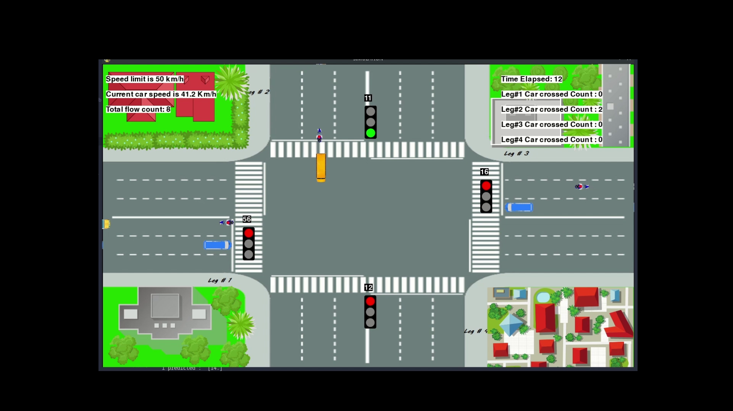

Slide 6
Benefits of AI Traffic System
Reduced congestion: By optimizing traffic light timing based on traffic volume, the system can reduce congestion and travel times.
Improved air quality: Reduced congestion leads to fewer cars idling and emitting pollutants, resulting in improved air quality.
Cost savings: Improved traffic flow can lead to fuel savings and reduced vehicle wear and tear.
Improved safety: Reduced congestion can lead to fewer accidents caused by frustrated drivers
03
BENEFITS

Slide 7
Conclusion
AI traffic systems have the potential to significantly improve the efficiency and safety of our roads. By optimizing traffic light timings based on real-time traffic data, these systems can reduce congestion and travel times, resulting in cost savings, improved air quality, and reduced vehicle wear and tear. Additionally, by reducing congestion and frustrated driving, AI traffic systems can increase safety on the roads and decrease the likelihood of accidents. The implementation of such systems has already shown positive results, and further research and development of these technologies could lead to even greater improvements in traffic management and urban mobility. AI traffic systems offer a promising solution to the problem of traffic congestion and its associated negative impacts.
04
CONCLUSION

Slide 8
References
ChatGPT
https://openai.com/blog/chatgpt
Google
https://www.google.com/
Kaggle
https://www.kaggle.com/
Youtube
https://www.youtube.com/
OpenCV
https://opencv.org/
Python Documentation
https://docs.python.org/3/
05
REFERENCES

Slide 9
Thank You
By:- Analytic Avengers

